Slide 1

Domain : Fin Tech
Personalized Financial Assistant: Chatbot for Expense Tracking
CODE MONKEYS

Slide 2

Problem Statement
Managing personal finances effectively is a common challenge, especially in a fast-paced digital world where expenses often go untracked and savings goals remain unmet. Individuals struggle to gain a clear understanding of their monthly expenditure, categorize their spending habits, and identify opportunities for savings or investments

Slide 3
Solution
Personalized Financial Assistant
To tackle the challenges of managing personal finances, we propose an all-in-one finance management app. It will enable real-time expense tracking by integrating with users' bank accounts and offer receipt scanning for cash transactions. Expenses will be categorized automatically, and visual dashboards will provide insights into spending habits. The app will also include personalized budgeting tools to help users set and achieve financial goals effectively.

Slide 4

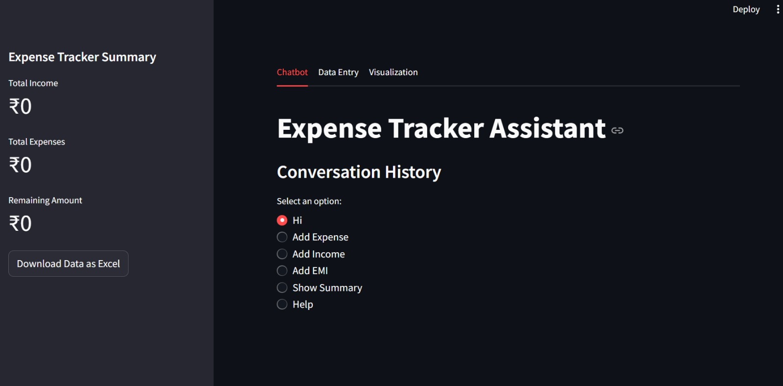
CURRENT PROGRESS

Slide 5
Dependencies and Showstopper
Real-Time Expense Tracking : Provide options for manual entry of cash expenses and receipt scanning using OCR technology for seamless tracking.
Personalized Budgeting Tools : Enable users to set spending limits for various categories and track adherence to their budgets.
1
3
2
Expense Categorization and Visualization: Automatically categorize expenses into predefined categories like food, transportation, and entertainment using AI.
4
Savings and Investment Guidance : Suggest tailored saving strategies based on users' income, expenses, and financial goals.

Slide 6

Team Name: Bro Code
Moulya Srivathsa
BNM Institute of Technology
Bangalore
Srusti Sumukha
BNM Institute of Technology
Bangalore
Suhas C Patel
BNM Institute of Technology
Bangalore
Prathyush K S
BNM Institute of Technology
Bangalore

Slide 7
THANK YOU

